Slide 1
Natural Language Processing - Introduction
EXTC – BE(SEM VIII) – NLP
Prof. Priyanka Kadam
Assistant Professor
Dept. of Electronics and Telecommunication
SIES Graduate School of Technology

Slide 2
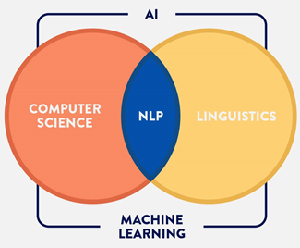
Natural Language Processing - Introduction
Natural Language Processing (NLP) is a branch of AI that helps computers to understand, interpret and manipulate human languages like English or Hindi to analyze and derive it’s meaning.
NLP helps developers to organize and structure knowledge to perform tasks like translation, summarization, named entity recognition, relationship extraction, speech recognition, topic segmentation, etc.

Slide 3
Fields of NLP
Speech Recognition — The translation of spoken language into text.
Natural Language Understanding (NLU) — The computer’s ability to understand what we say.
Natural Language Generation (NLG) — The generation of natural language by a computer.

Slide 4
Speech Recognition
First, the computer must take natural language and convert it into artificial language. This is what speech recognition, or speech-to-text, does. This is the first step of NLU.
Hidden Markov Models (HMMs) are used in the majority of voice recognition systems nowadays.
These are statistical models that use mathematical calculations to determine what you said in order to convert your speech to text.
HMMs do this by listening to you talk, breaking it down into small units (typically 10-20 milliseconds), and comparing it to pre-recorded speech to figure out which phoneme you uttered in each unit (a phoneme is the smallest unit of speech).
The program then examines the sequence of phonemes and uses statistical analysis to determine the most likely words and sentences you were speaking.

Slide 5
Natural Language Understanding (NLU)
The next and hardest step of NLP, is the understanding part.
First, the computer must comprehend the meaning of each word. It tries to figure out whether the word is a noun or a verb, whether it’s in the past or present tense, and so on. This is called Part-of-Speech tagging (POS).
A lexicon (a vocabulary) and a set of grammatical rules are also built into NLP systems. The most difficult part of NLP is understanding.
The machine should be able to grasp what you said by the conclusion of the process.
There are several challenges in accomplishing this when considering problems such as words having several meanings (polysemy) or different words having similar meanings (synonymy), but developers encode rules into their NLU systems and train them to learn to apply the rules correctly.

Slide 6
Natural Language Generation (NLG)
NLG is much simpler to accomplish.
NLG converts a computer’s artificial language into text and can also convert that text into audible speech using text-to-speech technology.
First, the NLP system identifies what data should be converted to text.
If you asked the computer a question about the weather, it most likely did an online search to find your answer, and from there it decides that the temperature, wind, and humidity are the factors that should be read aloud to you.
Then, it organizes the structure of how it’s going to say it. This is similar to NLU except backwards.
NLG system can construct full sentences using a lexicon and a set of grammar rules.
Finally, text-to-speech takes over. The text-to-speech engine uses a special model to evaluate the text and identify breaks, duration, and pitch.
The engine then combines all the recorded phonemes into one cohesive string of speech using a speech database.

Slide 7
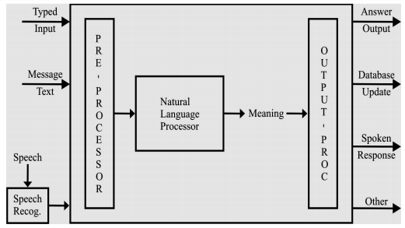
Generic NLP system

Slide 8
Pre-processing
Tokenization:
Tokenization is a process of converting sentence into a chain of words so that processing word by word can be easily performed. Here we use white space character for tokenization.
New York and rock ’n’ roll are individual words despite the fact that they contain spaces, but for many applications we’ll need to separate I’m into the two words I and am.

Slide 9
Stop word removal
Stop words are the most frequently occurring words which slow down the processing of documents as these
words are irrelevant. Hence we remove the stop words to enhance the speed of searching.
A corpus of stop words is used to filter out the stop words from the documents.
You can even customize lists of stopwords to include words that you want to ignore.
Let’s say you want to classify customer service tickets based on their topics. In this example: “Hello, I’m having trouble logging in with my new password”, it may be useful to remove stop words like “hello”, “I”, “am”, “with”, “my”, so you’re left with the words that help you understand the topic of the ticket: “trouble”, “logging in”, “new”, “password”.

Slide 10
Stemming
It is also known as the text standardization step where the words are stemmed or diminished to their root/base form.
For example, words like ‘programmer’, ‘programming, ‘program’ will be stemmed to ‘program’.
But the disadvantage of stemming is that it stems the words such that its root form loses the meaning or it is not diminished to a proper English word.

Slide 11
Lemmatization
It stems the word but makes sure that it does not lose its meaning.
Lemmatization has a pre-defined dictionary that stores the context of words and checks the word in the dictionary while diminishing.
Original Word | After Stemming | After Lemmatization
goose | goos | goose
geese | gees | goose

Slide 12
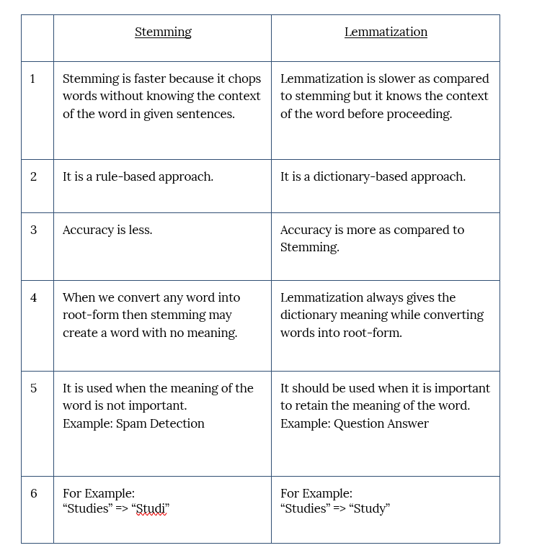
Difference between Stemming and Lemmatization

Slide 13
Ambiguity and Uncertainty in Language
Ambiguity, generally used in natural language processing, can be referred as the ability of being understood in more than one way.
Natural language is very ambiguous. NLP has the following types of ambiguities −
Lexical Ambiguity
The ambiguity of a single word is called lexical ambiguity. For example, treating the word silver as a noun, an adjective, or a verb.
There are various types of lexical ambiguity, including:
Polysemy: A single word having multiple related meanings. For example, the word "bank" can refer to a financial institution or the side of a river.
Homonymy: Different words with the same spelling or pronunciation but different meanings. For instance, "bat" can refer to a flying mammal or a piece of sports equipment.
Heteronymy: Words with the same spelling but different pronunciations and meanings. An example is "tear," which can mean to rip or a drop of liquid from the eye.

Slide 14
Ambiguity and Uncertainty in Language
Syntactic Ambiguity
This kind of ambiguity occurs when a sentence is parsed in different ways.
types of syntactic ambiguity:
Structural Ambiguity: This occurs when the syntactic structure of a sentence allows for multiple interpretations. For example:
"I saw the man with the telescope." Is the man holding the telescope or did the speaker use the telescope to see the man?
Attachment Ambiguity: In sentences with multiple clauses, the attachment of a phrase or clause to one part of the sentence over another can lead to ambiguity. For instance:
"I told my friend I would help." Did the speaker tell their friend that they would help, or did they tell their friend about their intention to help someone else?
Modifier Attachment Ambiguity: This occurs when a modifier, such as an adjective or adverb, can be associated with more than one word in a sentence. For example:
"She almost told him everything." Did she almost tell him everything, or did she tell him almost everything?
Coordination Ambiguity: Ambiguity can arise in sentences with coordination, where multiple phrases are joined by conjunctions. For example:
"She likes chocolate and vanilla ice cream." Does she like both flavors, or does she like chocolate ice cream and vanilla ice cream separately?

Slide 15
Ambiguity and Uncertainty in Language
Semantic Ambiguity
This kind of ambiguity occurs when the meaning of the words themselves can be misinterpreted.
In other words, semantic ambiguity happens when a sentence contains an ambiguous word or phrase.
For example, the sentence “The car hit the pole while it was moving” is having semantic ambiguity because the interpretations can be “The car, while moving, hit the pole” and “The car hit the pole while the pole was moving”.
Anaphoric Ambiguity
This kind of ambiguity arises due to the use of anaphora entities in discourse. For example, the horse ran up the hill. It was very steep. It soon got tired. Here, the anaphoric reference of “it” in two situations cause ambiguity.

Slide 16
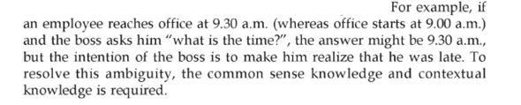
Ambiguity and Uncertainty in Language
Pragmatic ambiguity
Such kind of ambiguity refers to the situation where the context of a phrase gives it multiple interpretations.
In simple words, we can say that pragmatic ambiguity arises when the statement is not specific and the context does not provide the information needed to clarify the statement. Information is missing, and must be inferred.
For example, the sentence “I like you too” can have multiple interpretations like I like you (just like you like me), I like you (just like someone else dose).

Slide 17
Stages of NLP
The analysis of NL is broken down into various broad levels such as phonological, morphological, lexical, syntactic, semantic, pragmatic and discourse analysis.
For example some applications require the first 3 levels only. Also, the levels could be applied in a different order independent of their granularity

Slide 18
Stages of NLP
Level 1 – Phonology
This level is applied only if the input is a speech. Input is acoustic waveform and output is string of words.
It deals with speech recognition and generation. That is interpretation of speech sounds within and across words
Speech sound might give a big hint about the meaning of a word or a sentence.
The area of computational linguistic that deals with speech analysis is computational phonology.

Slide 19
Morphological Analysis
Morphology is study of internal structure of words. Given a particular word in a language, what are the different meaningful units it is made up of and each small unit is called a morpheme.
cat : stem cats: cat + s unhappy happily unhappily
cats : N +PL cat: N+SG sort: V+SG sorts: V+PL sort: N+PL
Computational tool to perform morphological parsing is finite state transducer.
[Note: In Information Retrieval, document and query terms can be stemmed to match the morphological variants of terms between the documents and query; such that the singular form of a noun in a query will match even with its plural form in the document, and vice versa, thereby increasing recall.]

Slide 20
Lexical Analysis
It deals with understanding of everything about distinct words according to their position in the speech, their meanings and their relation to other words.
It identify and analyze the structure of words with respect to their lexical meaning and part-of-speech.
Lexicon is a dictionary. Lexicon of a language means the collection of words and phrases in a language.
Validity of word is checked according to lexicon.

Slide 21
Syntactic Analysis
Syntactic Analysis (Parsing) − It involves analysis of words in the sentence for grammar and arranging words in a manner that shows the relationship among the words.
The sentence such as “The school goes to boy” is rejected by English syntactic analyzer.
Syntax refers to the study of formal relationships between words of sentences. Validity of a sentence is checked according to rules of grammar.
To perform syntactic analysis, the knowledge of grammar and parsing techniques is required.
Grammar is formal specification of rules allowable in the language.
Parsing is a method of analysing a sentence to determine its structure according to the grammar. CFG is used for syntactic analysis.
Two basic parsing techniques are top down parsing and bottom-up parsing.
I eat banana.
I banana eat.

Slide 22
Semantic Analysis
Level 5 – Semantic Analysis
Semantics deals with the meaning of natural language sentences. Meaning of the sentences is understood in this phase.
It draws the exact meaning or the dictionary meaning from the text.
The text is checked for meaningfulness. It is done by mapping syntactic structures and objects in the task domain. The semantic analyzer disregards sentence such as “hot ice-cream”.
e.g.
She eats banana
Machine eats banana.

Slide 23
Examples on Semantic Analysis
Example: The cat is on the mat.
Syntactic Structure: Subject ("The cat"), verb ("is"), preposition ("on"), and object ("the mat").
Objects in the Task Domain: Entities represented by "cat" and "mat."
Mapping Syntactic Structures to Meaning: The cat is located on the mat.
Meaningfulness Check: The sentence is meaningful and describes a spatial relationship.
Example: The sun rises in the east.
Syntactic Structure: Subject ("The sun"), verb ("rises"), preposition ("in"), and object ("the east").
Objects in the Task Domain: Entities represented by "sun" and "east."
Mapping Syntactic Structures to Meaning: The sun undergoes the action of rising, and the direction is specified as east.
Meaningfulness Check: The sentence is meaningful, describing the natural phenomenon of sunrise.

Slide 24
Pragmatic Analysis
Pragmatic :
During this, what was said is re-interpreted on what it actually meant. It involves deriving those aspects of language which require real world knowledge.
Explains how extra meaning is read into texts without actually being encoded in them. This requires much world knowledge, including the understanding of intentions, plans, and goals.
Consider the following 2 sentences:
The city counsellors refused the demonstrators a permit because they feared violence.
The city counsellors refused the demonstrators a permit because they advocated revolution.
The meaning of “they” in the 2 sentences is different. In order to figure out the difference, world knowledge in knowledge bases and inferencing modules should be utilized.

Slide 25
Examples of Pragmatic Analysis
Statement: "I'm freezing."
Literal Meaning: Describing a low temperature or feeling very cold.
Pragmatic Interpretation: In a social context, this statement might be a subtle request for someone to adjust the thermostat or offer a blanket.
Statement: "Nice weather we're having."
Literal Meaning: A comment on the current weather conditions.
Pragmatic Interpretation: In a social context, this statement is often used as a conversation starter rather than a literal observation about the weather.
Statement: "Do you have the time?"
Literal Meaning: A straightforward question about the current time.
Pragmatic Interpretation: In a social context, this question might be a way of initiating a conversation or gauging the willingness of the other person to engage.

Slide 26
Thank You!
(priyankak@sies.edu.in)

Slide 27
https://www.tutorialspoint.com/natural_language_processing/natural_language_processing_quick_guide.htm
Colab Implement:
https://colab.research.google.com/drive/1eAipYEBJK3zWLF5T8xDFT2iLtwEM8Olf?authuser=1#scrollTo=ihuTtwAnoTof

